Slide 1
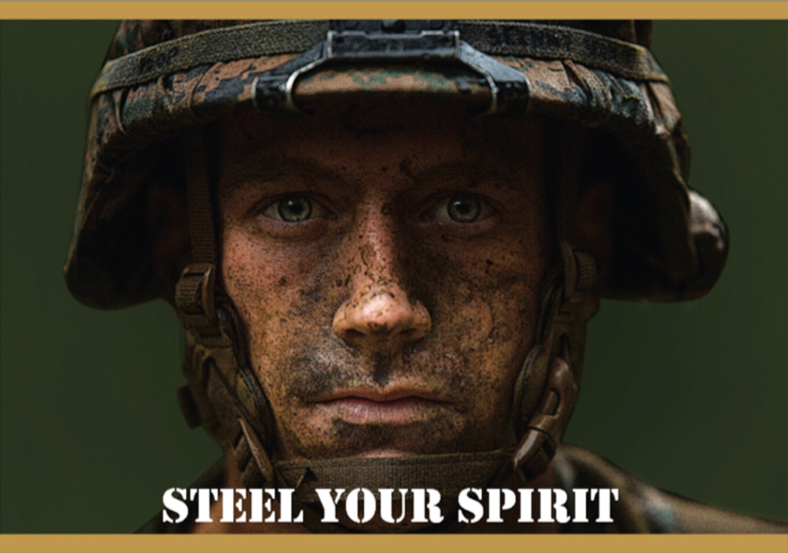
SPIRITUAL FITNESS
“Steel your spirit so that you can better deal with adversity. Prepare yourself so you will be ready for the decisive moment in combat.” – General Neller
(Message to the Force 2017: “Seize the Initiative”)

Slide 2
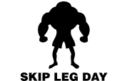
Friends don’t let friends…
Notes:
-“Finish the phrase (Friends don’t let friends…). “ Discuss then reveal answer: Friends don’t let friends skip leg day.
-“How many of you have seen this or something like this before?” “Why is it funny?” What does it mean?
-Discuss what happens when our work out becomes too narrow and neglects other aspects of fitness.
-How does that lesson apply to life?

Slide 3
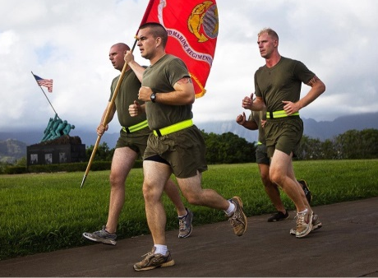

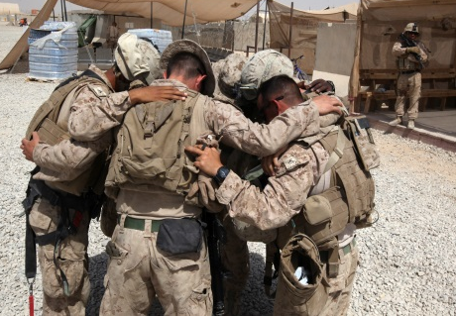
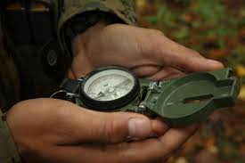
Total Fitness
Physical
Mental/
Emotional
Social
Spiritual
Notes:
-How is wellness a combination of these different aspects of our being?
-How are these elements intertwined?
-What happens when we focus too much on one area and neglect others?
-How does this apply to warriors?

Slide 4
The Need for Balance
“The violence of combat assaults the psyches, confuses ethics, and tests souls. This is not only a result of the violence suffered. It is also a result of the violence inflicted. Warriors suffer from wounds to their bodies, to be sure, but because they are involved in killing people they also suffer from their compromises with, or outright violations of the moral norms of society and religion…
The preparation for these aspects of combat must be done by the individual, in the quiet places, alone in communion with his or her own soul.”
Karl Marlantes, What it is Like to Go to War. P. xi-xii.
Notes:
Warriors are unique because in order to be good at what they do, they have to really develop parts of themselves that can throw the other areas off balance. In order to be able to manage the internal tug-of-war that can take place, warriors need to be intentional about balancing all areas of there life.

Slide 5
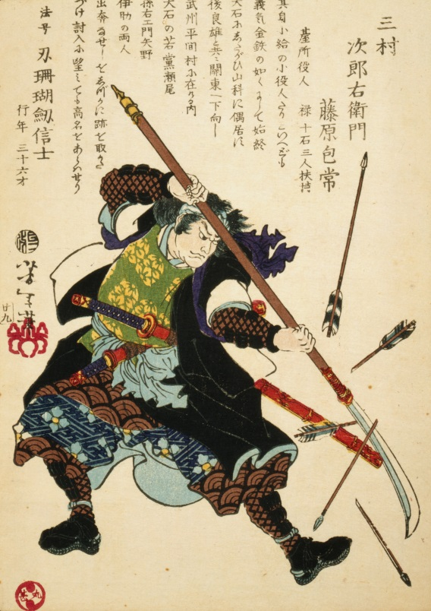
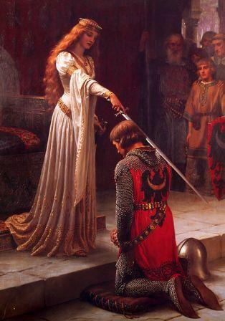
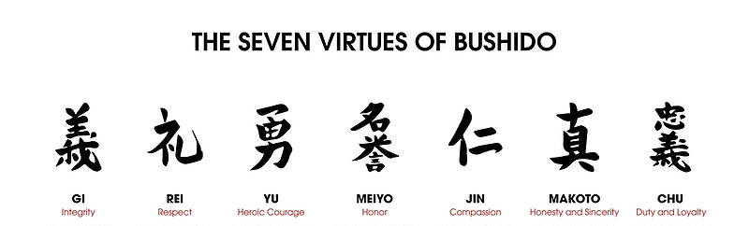
Warrior
Code
Notes:
Because of this tendency toward imbalance, some of the most notable groups of warriors in history held strongly to a code of conduct which pushed them to give equal attention to other areas of their life. With medieval Knights it was known as chivalry. Among the samurai it was Bushido.
-Take a look at these 7 virtues of Bushido. What do they have to do with being a good warrior?
-Why do you think these were so important? Did they make them better warriors?
-The greatest warriors focused on discipline in all 4 areas of fitness to maintain balance.

Slide 6
Total Fitness
Mental/
Emotional
Physical
Social
Spiritual
Notes:
Notice how those 7 virtues of bushido cover all the aspects of fitness.
This presentation will focus on the spiritual aspect of fitness

Slide 7
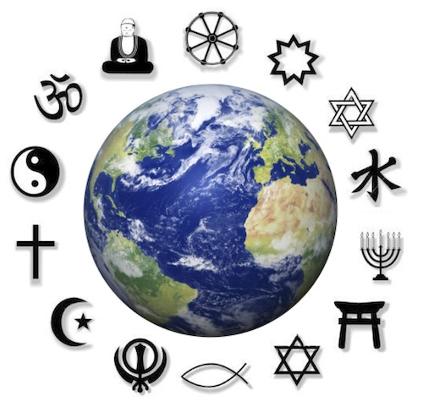
Religion and Spirituality
Notes:
-We should pause a moment to clarify something important…
-When we talk about spirituality are we referring to religion? (Maybe, if that is how you personally connect spiritually)
-Is there a difference between religion and spirituality?
-Is it possible to be spiritual but not religious? Is it possible to be religious but not spiritual? (It’s not supposed to be, but it happens)
Spirituality is an internal experience of finding meaning and connection, whereas religion is the external institution that seeks to help people develop internal spirituality.
Just belonging to a religion doesn’t guarantee spirituality, but religion has been shown to be an extremely effective way to develop spirituality. However, being externally religious without being internally spiritual has been linked to various mental health problems. Our goal is to help you understand and develop the important elements of intrinsic spirituality, whether you choose to use religion or not.

Slide 8
Research Shows
…that people who are religious/spiritual tend to enjoy these benefits:
Physical Health
Longer Life
Lower rates of vast array of diseases.
Better coping with pain, death, disease and stress.
Faster recovery from injury and illness.
Lower rates of risky behavior.
Health Behaviors (exercise, hygiene, safety, etc).
Mental Health
Higher levels of happiness, hope, satisfaction and wellbeing.
Lower rates of depression and anxiety.
Lower rates of suicide.
Greater stress resilience.
Greater level of self-control.
Higher achievement in school and work.
Social Health
Greater marital satisfaction and adjustment.
Less likely to engage in delinquent behavior.
Lower levels of hostility
Higher levels of prosocial behavior.
Healthier attachments
-Richards, S. (2005). A spiritual Strategy for Counseling and Psychotherapy. American Psychological Association, pp. 19-26.
-Koenig, HG; King, D: Carson, VB. (2012) Handbook of religion and health.
-Pargament, K. I., Exline, J. J., & Jones, J. W. (2013). APA handbook of psychology, religion, and spirituality (Vol 1): Context, theory, and research. American Psychological Association.
Notes:
Research shows that spirituality can have all kinds of positive effects on your life. Here are just a few.

Slide 9
Research on Military Personnel Shows
…that MILITARY MEMBERS who are religious/spiritual tend to enjoy these benefits:
Less anxiety about death.¹
Higher levels of moral courage and moral action.²
More likely to embrace military values.²
More positive and hopeful outlook when deployed.²
Fewer negative emotions when deployed.²
Less fatigue and fewer somatic complaints when deployed.²
Lower rates of PTSD, suicide, depression, anger, aggression, and higher rates of quality of life, positive coping, and mental well-being after deployment.³
Families are more resilient after deployment.⁴
More likely to experience post-traumatic growth after trauma.⁵
Notes:
Research shows that spirituality can have all kinds of positive effects on your life. Here are just a few.

Slide 10
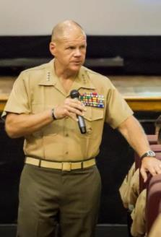
ALMAR (Oct 2016)
“Fitness is a vital part of being a United States Marine. Although we all understand the importance of being physically fit, it is also important to remember the other three aspects of overall fitness: spiritual, mental, and social. All of these aspects are essential to the well-being of each individual Marine and Sailor, and our Corps as a whole. . .
“Research indicates that spiritual fitness plays a key role in resiliency, in our ability to grow, develop, recover, heal, and adapt. Regardless of individual philosophy or beliefs, spiritual well-being makes us better warriors and people of character capable of making good choices on and off duty. . .
“By attending to spiritual fitness with the same rigor given to physical, social and mental fitness, Marines and Sailors can become and remain the honorable warriors and model citizens our Nation expects.”
Semper Fidelis,
R. B. Neller, General, U.S. Marine Corps,
Commandant of the Marine Corps
Notes:
-Spirituality has also been shown in research to insulate against PTSD, combat stress injury and moral injury. For all of these reasons, the Marine Corps, under the direction of the Commandant is putting renewed emphasis on spiritual fitness. The Marine corps isn’t interested in telling you what faith to join, or even to join one at all. What it is telling you is that spirituality is important to make you a balanced warrior and it should be developed in whatever way you feel is best for you. If you choose religion, great! Religion is the most common way to develop spirituality. If you choose to be spiritual without religion, great! In this brief we are going to give you some general principles that we feel will help you better “steel your spirit”, whether you are religious or not.

Slide 11
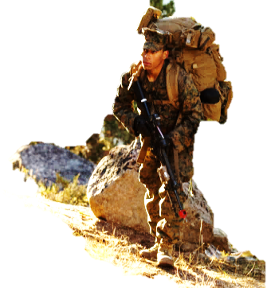
Spiritual Fitness
Life's Meaning/ Purpose
Hope for life/future
Sound Moral Decisions
Engaged in Core Values and beliefs
Engaged with family and community
Able to Forgive self and others
Respectful of others
Personal Faith
Faith is characterized as belief or trust in self and / or relationship with someone or something greater than one’s self.
Foundational Values
Values will guide choices, actions, and character displayed on and off duty.
Moral Living
The sources of moral living and decision making can impact daily decision making and actions.
Fit
Stressed
Depleted
Drained
Notes:
Spirituality may look different for different people and many people may already have specific beliefs and practices that help them promote spirituality. We have tried to identify the “active ingredients” or core elements of spirituality that may apply to all religions or forms of spirituality. Religions often provide these elements in the form of teachings, commandments and rituals, but whether you are religious or not, it can be really beneficial to evaluate each of these elements in your own life to improve spiritual fitness.

Slide 12
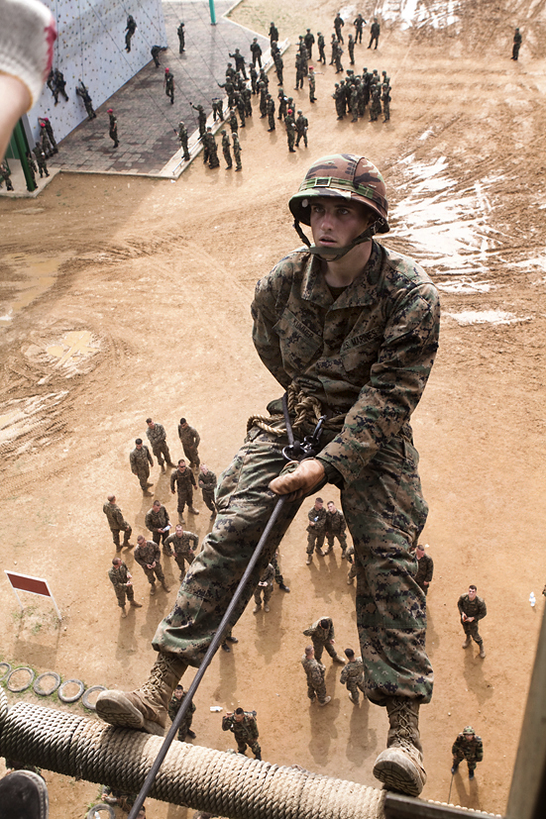
Personal Faith
What do you place your trust in?
Self (abilities)
Higher Self (intrinsic worth)
Family
Friends
Unit
Marine Corps
Country
Human Spirit
Faith Community
God/ Higher Power
Notes:
When learning to rappel, what is the hardest part? Why? (putting trust in the rope)
The goal is to help recruits realize, “If I put my trust in this, I will be able to do things I might now be able to otherwise.”
What are some things that we might put our faith in? List
What might the benefits be that come from trusting in each of those things? (Note there are different levels of benefits that come from different types of faith).

Slide 13

Results of Personal Faith
Connection
Stability
Hope and Confidence
Notes:
Once a person learns to trust the rappelling equipment, they find that they actually have greater freedom and versatility than they would alone. Similarly, relying on personal faith can create greater connection (to higher self, to community, to nature, to Marine Corps, to God, etc.) stability (less likely to stumble or become thrown off balance in life by challenges and pitfalls), and greater hope and confidence in the future.

Slide 14
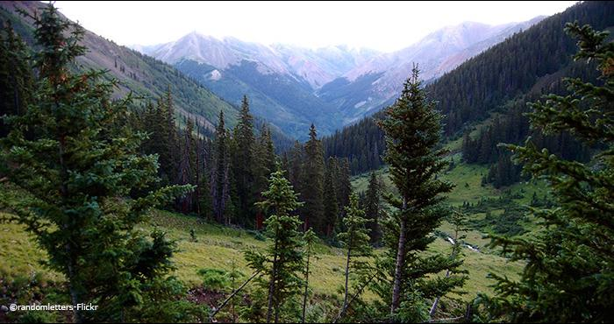
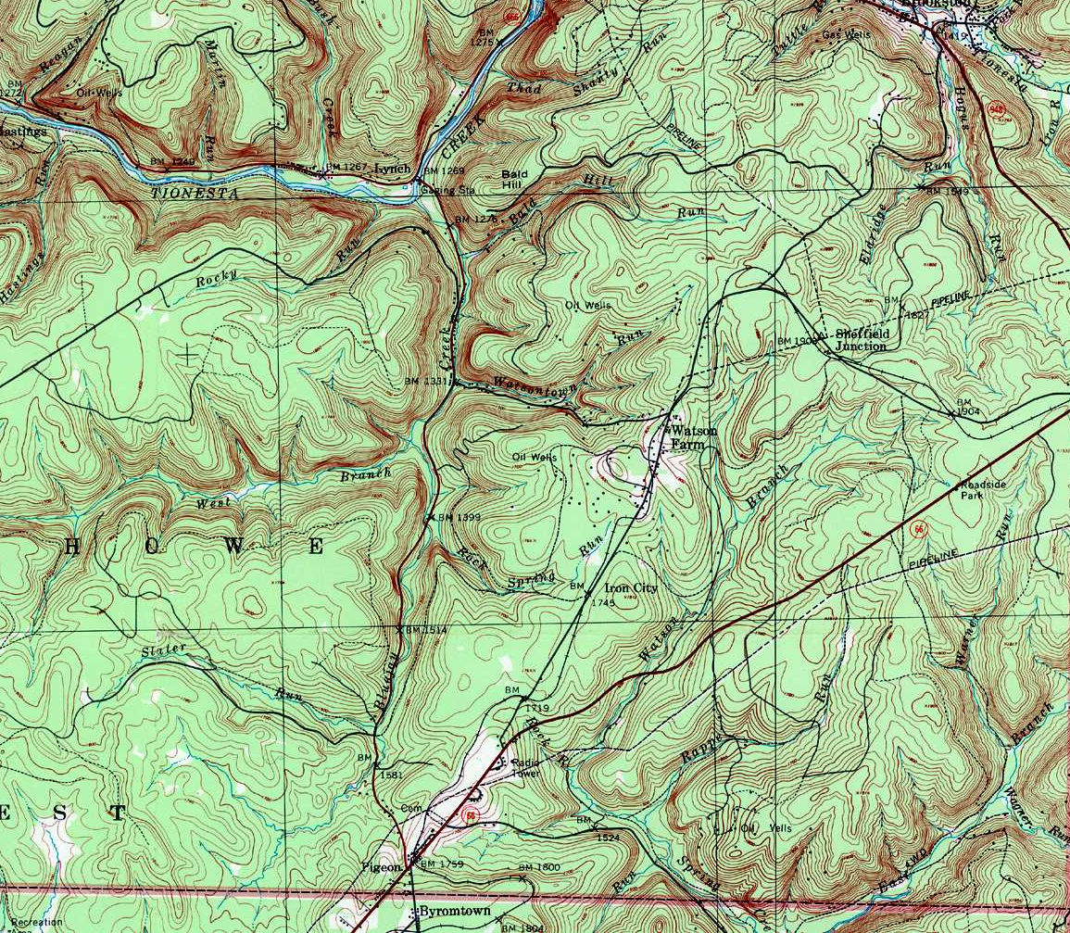
Lost
Notes:
Imagine that you are lost in the woods. You need to find your way out, but you don’t even know which direction to go. How would you figure it out? What resources would you use to plan your path?
What if you had a map? How would that change things?
What would you do using a map?

Slide 15
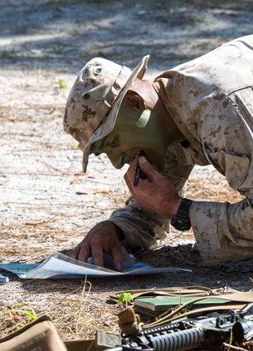
Foundational values
See the Big Picture
(Meaning)
Understand the Terrain
(Values)
Chart a Course
(Purpose/Mission)
Notes:
-One of the first things you’ll want to do is to get an overview of the land so you can see the big picture. You will likely seek to understand the terrain and look for landmarks to guide you and areas that you will want to avoid. Once you have created a mental map, you can then begin to map your course. If you already have a map, great! But the process is still the same.
-So how can this process be applied to life?
-How can we understand the big picture? (Meaning)
-Foundational values are like landmarks that help us understand life’s terrain. We can use them to help us chart a course to a good life.

Slide 16
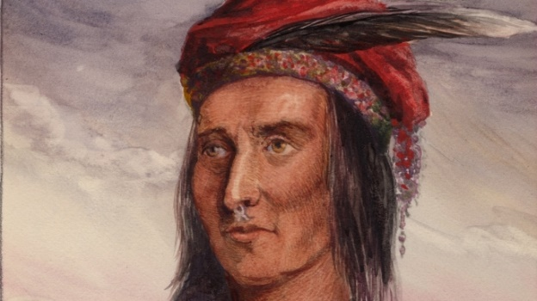
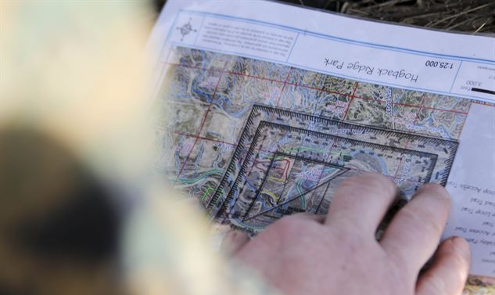
Life Map
Tecumseh
Live your life that the fear of death can never enter your heart.
Trouble no one about his religion.
Respect others in their views and demand that they respect yours.
Love your life, perfect your life, beautify all things in your life.
Seek to make your life long and of service to your people.
Prepare a noble death song for the day when you go over the great divide.
Always give a word or sign of salute when meeting
or passing a friend, or even a stranger, if in a lonely place.
Show respect to all people, but grovel to none.
When you rise in the morning, give thanks for the light, for your life,
for your strength.
Give thanks for your food and for the joy of living.
If you see no reason to give thanks, the fault lies in yourself.
Touch not the poisonous firewater that makes
wise ones turn to fools and robs their spirit of its vision.
When your time comes to die, be not like those whose hearts are filled with fear of death,
so that when their time comes they weep and pray
for a little more time to live their lives over again in a different way.
Sing your death song, and die like a hero going home.
Notes:
How long did it take to chart your course when doing land navigation during training? How much time have you put into actually sitting down and creating your own life map and charting the course that represents the way you want to live your life?
Here is an example of a life map built on foundational values: (Tecumseh quote)

Slide 17
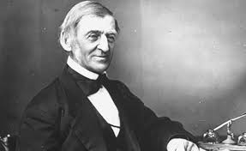
Life Map
Ralph Waldo Emerson
“To laugh often and much; To win the respect of intelligent people and the affection of children; To earn the appreciation of honest critics and endure the betrayal of false friends; To appreciate beauty, to find the best in others; To leave the world a bit better, whether by a healthy child, a garden patch, or a redeemed social condition; To know even one life has breathed easier because you have lived. This is to have succeeded.”
Notes:
Here is an example of a life map built on foundational values: (Ralph Waldo Emerson quote)
What is your definition of a life well-lived?

Slide 18
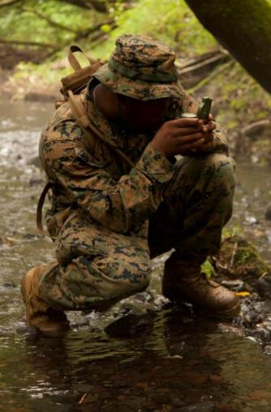
Moral living
What do I need to do every day to get where I want to go?
What do I need to avoid that might throw me of course?
How do I live a good, honorable life?
Notes:
After you have identified sources of faith and strength in your life, and you have create a life map outlining your foundational meaning and values, it is time to take action. Moral living is where the rubber meets the road of spirituality.
Even with a life map, it is possible to get off course. Each of us needs our own personal moral compass.
How do you use a compass for land navigation? (use it to line up your course. Many compasses have a viewer which shows the goal destination, and blocks out the incorrect path).
-Our own personal compass helps us know if the steps we are taking are on course, or if they are going to take us the wrong direction. We use the moral compass to promote moral living and make good choices.

Slide 19
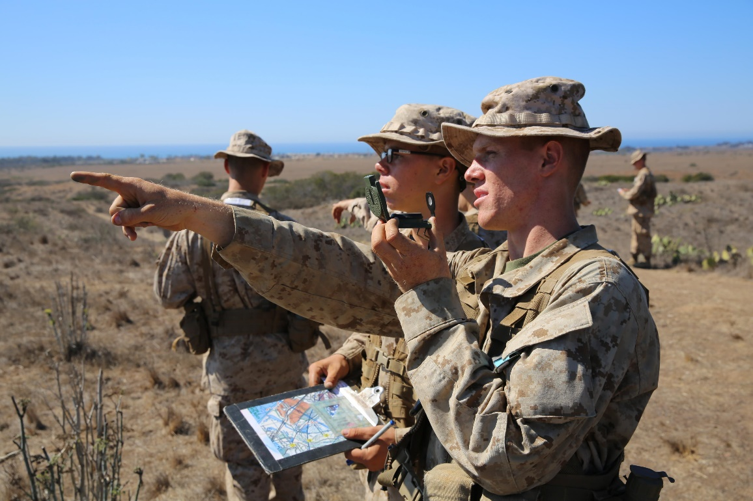
Don’t forget…
Use Waypoints
Make Constant Course Corrections
Notes:
Waypoints are a way of tracking progress and making sure that you stay on track. Small errors in direction, if not corrected, can, over time, result in being significantly off target. That can be avoided by making a series of smaller goals to help you get to your ultimate goal.
What are some types of waypoints in our spiritual journey that can help us reach our ultimate destination?
How do we make course corrections in life when we discover that our life is not on the right track?

Slide 20
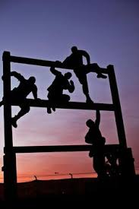
Obstacles
Self-betrayal
Complacency/Apathy
Past Trauma
Negative beliefs/experiences with religion.
Confusion about spirituality/religion
Notes:
There are various obstacles that can block our desire or ability to feel spiritual connection.
Confusion about spirituality/religion: Some people have had bad experiences or have a negative opinion about religion that causes them to be resistant to any talk about spirituality. Remember that spirituality and religion are not the same thing. It is possible to develop spirituality without religion.
Past Trauma- Trauma tends to shake a person’s world view. It can cause an individual to feel unsafe and disconnected. It may cause them to view themselves and the world around them in a much more negative way. It can create feelings of anger, mistrust and depression that can make it harder for spiritual growth. If this is the case for you, know that it is possible to redefine your world view and work through those feelings. You are encouraged to seek professional help.
Self-betrayal happens when we do things that are contrary to our own values and morals. This sometimes produces feelings of shame, which can inhibit spiritual connection and desire. Often, however, self-betrayal causes a person to push blame outward at others in order to rationalize the behavior, causing a significant amount of self-deception and anger. This tends to cause relationship problems and to block spiritual connection.
Complacency/Apathy- Just like with physical fitness, if you don’t exercise you will gradually fall out of shape. “If you don’t use it, you lose it” applies to spiritual fitness as well. If you want to maintain total fitness, you have to take action to “work out” ever aspect of your life.
The good news is that “obstacles” are not impassable. In fact they can promote growth. The marine corps alreay knows this. That is why they have you practices on obstacle courses.

Slide 21
Indicators
Life's Meaning/ Purpose
Hope for life/future
Sound Moral Decisions
Engaged in Core Values and beliefs
Engaged with family and community
Able to Forgive self and others
Respectful of others
Fit
Stressed
Depleted
Drained
Notes:
So now it is time to evaluate yourself.
-What are your spiritual strengths?
-What areas do you need to work on?
Make a plan to improve your spiritual fitness.

Slide 22
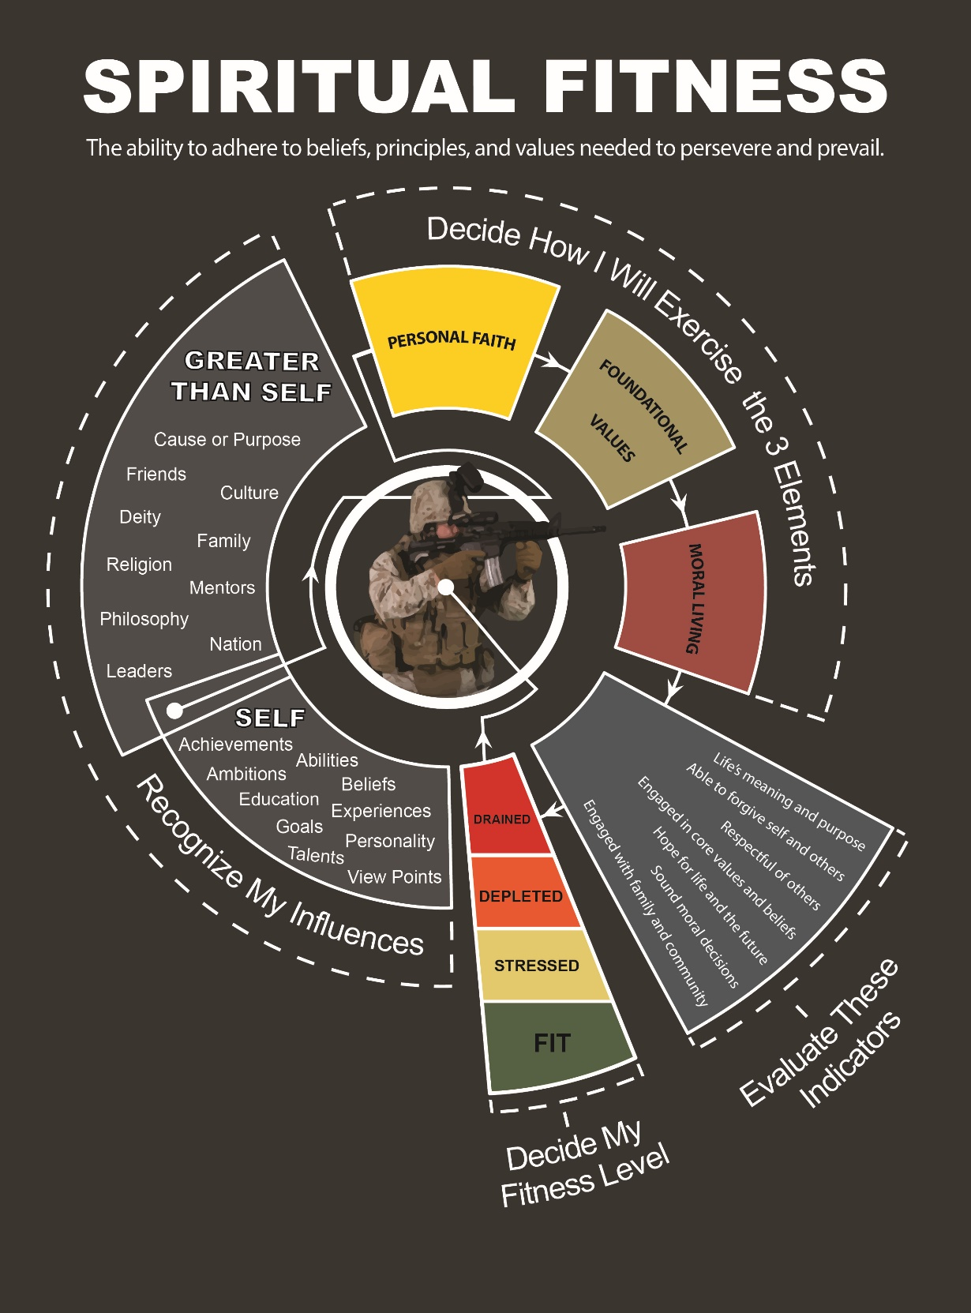
Resources

